Slide 1
DEADLOCKS

Slide 2
Deadlocks
A deadlock is a state where a set of processes request resources that are held by other processes in the set.
Assumptions
  System has only reusable resources
  Only exclusive access to resources
  Only one copy of each resource,
  States of a process: running or blocked
  Running state: process has all the resources
  Blocked state: waiting on one or more resource

Slide 3
Deadlocks
Resource Deadlocks
  A process needs multiple resources
  Deadlock occurs if each process in a set request resources held by another process in the same set, and it must receive all the requested resources to move further.
Communication Deadlocks
  Processes wait to communicate with other processes in a set.
  Each process in the set is waiting on another process’s message, and no process in the set initiates a message until it receives a message for which it is waiting.

Slide 4
Deadlock Handling Strategies
Deadlock Prevention: difficult
Deadlock Avoidance: before allocation, check for possible deadlocks.
  Difficult as it needs global state info in each site (that handles resources).
Deadlock Detection: Find cycles.
Deadlock detection algorithms must satisfy 2 conditions:
  No undetected deadlocks.
  No false deadlocks.

Slide 5
Graph Models
Nodes of a graph are processes. Edges of a graph the pending requests or assignment of resources.
Wait-for Graphs (WFG): P1 -> P2 implies P1 is waiting for a resource from P2.
Transaction-wait-for Graphs (TWF): WFG in databases.
Deadlock: directed cycle in the graph.
Cycle example:
P1
P2

Slide 6
AND, OR Models
AND Model
  A process/transaction can simultaneously request for multiple resources.
  Remains blocked until it is granted all of the requested resources.
OR Model
  A process/transaction can simultaneously request for multiple resources.
  Remains blocked till any one of the requested resource is granted.

Slide 7
DS Deadlock Detection, Cycle vs. Knot
The AND model of requests requires all resources currently being requested to be granted to un-block a computation
  A cycle is sufficient to declare a deadlock with this model
The OR model of requests allows a computation making multiple different resource requests to un-block as soon as any are granted
  A cycle is a necessary condition
  A knot is a sufficient condition

Slide 8
Deadlock in the AND model; there is a cycle
but no knot
No Deadlock in the OR model
P1
P3
P2
S1
P6
P4
P8
P5
P9
P7
P10
S2
S3

Slide 9
Deadlock in both the AND model and the OR model;
there are cycles and a knot
P1
P3
P2
S1
P6
P4
P8
P5
P9
P7
P10
S2
S3

Slide 10
DS Detection Requirements
Progress
  No undetected deadlocks
    All deadlocks found
    Deadlocks found in finite time
Safety
  No false deadlock detection
    Phantom deadlocks caused by network latencies
    Principal problem in building correct DS deadlock detection algorithms

Slide 11
Distributed Deadlocks
Centralized Control
  A control site constructs wait-for graphs (WFGs) and checks for directed cycles.
  WFG can be maintained continuously (or) built on-demand by requesting WFGs from individual sites.
Distributed Control
  WFG is spread over different sites.Any site can initiate the deadlock detection process.
Hierarchical Control
  Sites are arranged in a hierarchy.
  A site checks for cycles only in descendents.

Slide 12
Centralized Algorithms
Ho-Ramamoorthy 2-phase Algorithm
  Each site maintains a status table of all processes initiated at that site: includes all resources locked & all resources being waited on.
  Controller requests (periodically) the status table from each site.
  Controller then constructs WFG from these tables, searches for cycle(s).

Slide 13
  If no cycles, no deadlocks Otherwise, (cycle exists): Request for state tables again.
  Construct WFG based only on common transactions in the 2 tables.
  If the same cycle is detected again, system is in deadlock.
  Later proved: cycles in 2 consecutive reports need not result in a deadlock. Hence, this algorithm detects false deadlocks.

Slide 14
Why are centralized algorithms not favorable ?

Slide 15
Distributed Algorithms
Path-pushing: resource dependency information disseminated through designated paths (in the graph).
Edge-chasing: special messages or probes circulated along edges of WFG. Deadlock exists if the probe is received back by the initiator.
Diffusion computation: queries on status sent to process in WFG.
Global state detection: get a snapshot of the distributed system.

Slide 16
Path-pushing Algorithm
Obermarck’s Algorithm: used for databases. Transactions lock and wait on resources. One transaction can initiate atmost one sub-transaction at a given point in time.
  A site waits for deadlock-related information from other sites.
  The site combines the received information and local graph to build an updated (global) graph.
  Non-local portion of graph: distinguished by nodes called Ex (External).

Slide 17
Obermarck’s Path-Pushing Algorithm
Detection Process
Case 1: If Site S_{n} finds a cycle not involving ‘ex’, Deadlock exists.
Case 2: If Site S_{n} finds a cycle involving ‘ex’, Deadlock possible.
If Case 2 ->
Site S_{n} sends a message containing its detected cycles to other sites. All sites receive the message, update their WFG and re-evaluate the graph.
Consider Site S_{j} receives the message:
Site S_{j} checks for local cycles. If cycle found not involving ‘ex’ (of S_{j}) -> Deadlock exists.
If site S_{j} finds cycle involving ‘ex’ it forwards the message to other sites.
Process continues till deadlock found.

Slide 18
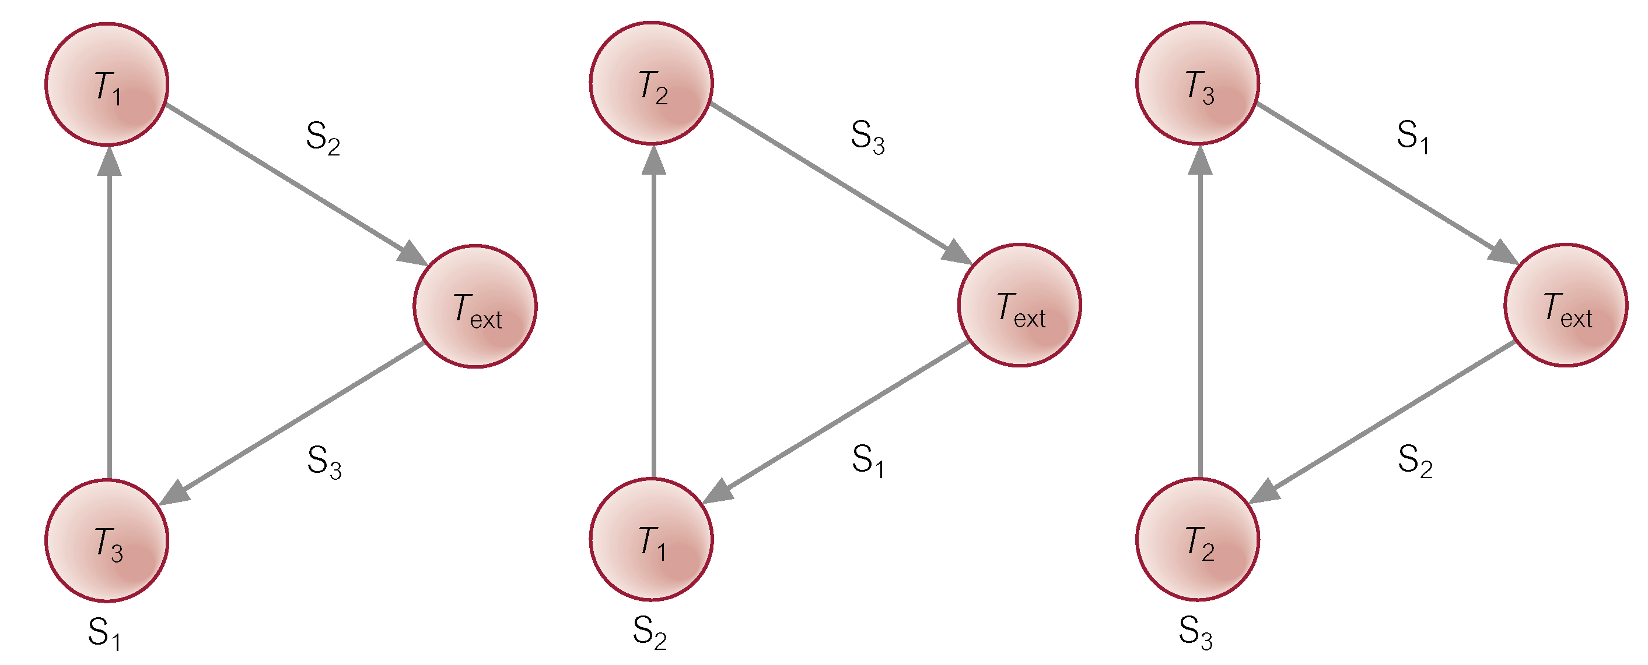
Distributed Deadlock Detection

Slide 19
Distributed Deadlock Detection
  S₁: T_{ext} → T₃ → T₁ → T_{ext}
  S₂: T_{ext} → T₁ → T₂ → T_{ext}
  S₃: T_{ext} → T₂ → T₃ → T_{ext}
Transmit LWFG for S₁ to the site for which transaction T₁ is waiting, site S₂.
LWFG at S₂ is extended and becomes:
  S₂: T_{ext} → T₃ → T₁ → T₂ → T_{ext}

Slide 20
Distributed Deadlock Detection
Still contains potential deadlock, so transmit this WFG to S₃:
  S₃: T_{ext} → T₃ → T₁ → T₂ → T₃ → T_{ext}
GWFG contains cycle not involving T_{ext}, so deadlock exists.

Slide 21
Problems: Obermarck’s detect false deadlocks -> snapshot of the distributed system taken asynchronously by different sites. Global cycles can change with time and may not by reflected in the local information.

Slide 22
Edge Chasing Algorithms
Chandy-Misra-Haas Algorithm (an AND model)
  probe messages M(i, j, k)
    initiated by Pj for Pi and sent to Pk
    probe messages work their way through the WFG and if they return to sender, a deadlock is detected

Slide 23
Chandy-Misra-Haas Algorithm
P1
P3
P1 launches
P2
Probe (1, 3, 4)
Probe (1, 9, 1)
S1
Probe (1, 6, 8)
P4
P6
P8
P5
P9
P7
P10
Probe (1, 7, 10)
S2
S3

Slide 24
Chandy-Misra-Haas’s Algorithm:
A probe(i, j, k) is used by a deadlock detection process Pi. This probe is sent by the home site of Pj to Pk.
  This probe message is circulated via the edges of the graph. Probe returning to Pi implies deadlock detection.
  Terms used:
    Pj is dependent on Pk, if a sequence of Pj, Pi1,.., Pim, Pk exists.
    Pj is locally dependent on Pk, if above condition + Pj,Pk on same site.
    Each process maintains an array dependenti: dependenti(j) is true if Pi knows that Pj is dependent on it. (initially set to false for all i & j).

Slide 25
Chandy-Misra-Haas’s Algorithm
Sending the probe:
if Pi is locally dependent on itself then deadlock.
else for all Pj and Pk such that
(a) Pi is locally dependent upon Pj, and
(b) Pj is waiting on Pk, and
(c ) Pj and Pk are on different sites, send probe(i,j,k) to the home site of Pk.
Receiving the probe:
if (d) Pk is blocked, and
(e) dependentk(i) is false, and
(f) Pk has not replied to all requests of Pj,
then begin
dependentk(i) := true;
if k = i then Pi is deadlocked else ...

Slide 26
Chandy-Misra-Haas’s Algorithm
Receiving the probe:
…….
else for all Pm and Pn such that
(a’) Pk is locally dependent upon Pm, and
(b’) Pm is waiting on Pn, and
(c’) Pm and Pn are on different sites, send probe(i,m,n) to the home site of Pn.
end.

Slide 27
C-M-H Algorithm: Example
P2
P1
P3
probe(1,3,4)
probe(1,7,1)
P4
P7
P6
P5

Slide 28
Deadlock Resolution
  Efficient resolution of deadlock requires knowledge of all processes and resources involved in the deadlock
  in many algorithms more than one processes may detect the same deadlock
Race Condition:
  Two processes block at the same time and send probes
  Both discover the cycle in parallel

Slide 29
Solution
  use of process priorities can help to address these issues.. consider priorities introduced in Obermarck’s algorithm.
  Highest priority process initiates and detects deadlock (initiations by lower priority ones are suppressed).

Slide 30
Resolution
  When deadlock is detected, lowest priority process(es) can be aborted to resolve the deadlock.
  Resolving a deadlock requires that
    victim is terminated and resources restored to a proper state
    detection info for victim flushed out from the system quickly since otherwise phantom deadlocks may be detected
    detection and resolution interact extensively

Slide 31
Differences between
deadlock & starvation
livelock & deadlock
A Deadlock detection algorithm based on global state detection

